Slide 1
Topic: Electricity EQ: What are the units of electricity?
Mrs Parlevliet
Year 11 Essentials

Slide 2
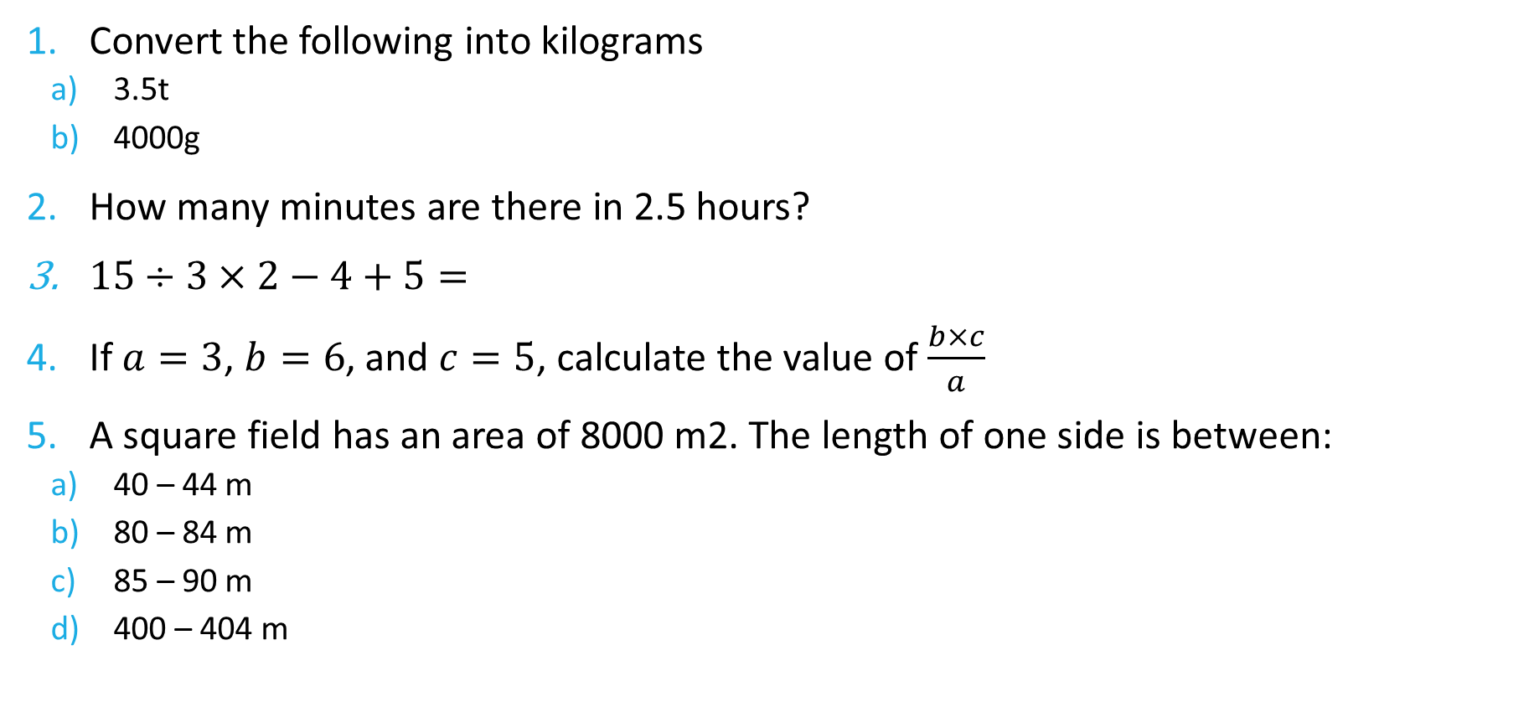
FiVe Questions
Convert the following into kilograms
3.5t
4000g
How many minutes are there in 2.5 hours?
$15÷3×2−4+5=$
If $a=3$, $b=6$, and $c=5$, calculate the value of $\frac{b×c}{a}$
A square field has an area of 8000 m2. The length of one side is between:
40 – 44 m
80 – 84 m
85 – 90 m
400 – 404 m

Slide 3
24
7
30
Topic: Electricity
Date: XX/XX/2021
EQ – What are the units of electricity?
How is energy used in electricity measured?
The energy used to run electrical appliances is measured in watts or kilowatts.
What is a kilowatt hour?
An electricity account measures the use of electrical energy in kilowatt hours.
Examples:
A heater rated at 1 kilowatt or 1000 watts means that when it is in use for one hour, 1 kilowatt of energy will be used.
A 40 watt light globe uses 0.04 kilowatt hours of energy per hour
1 kilowatt = 1kW = 1000 watts
1 kilowatt hour = 1kWh (A unit of energy equivalent to 1kW of power used in one hour)

Slide 4
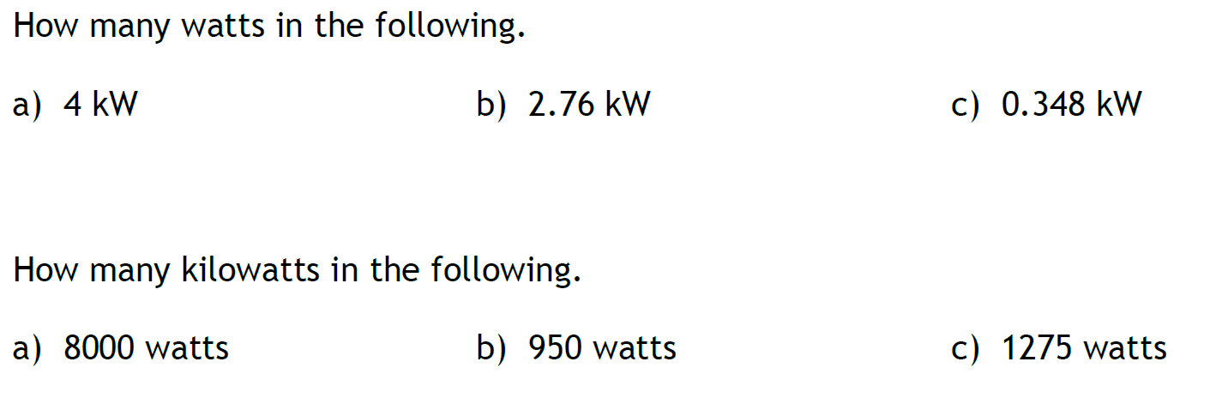
Guided Practice
4000 W
2760 W
348 W
8 kW
0.95 kW
1.275 kW

Slide 5

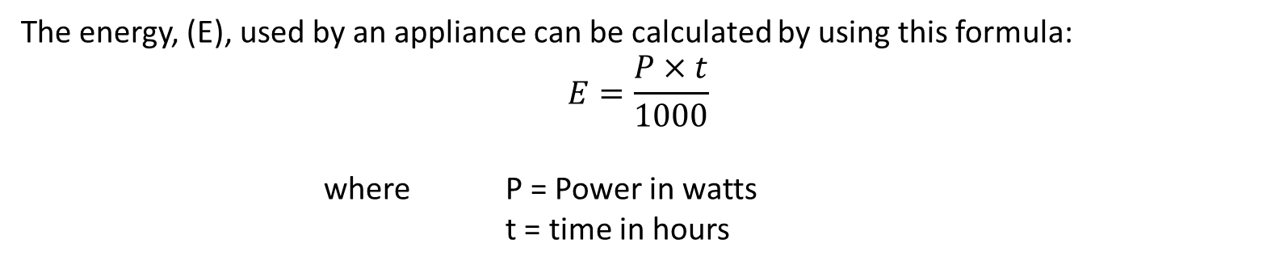
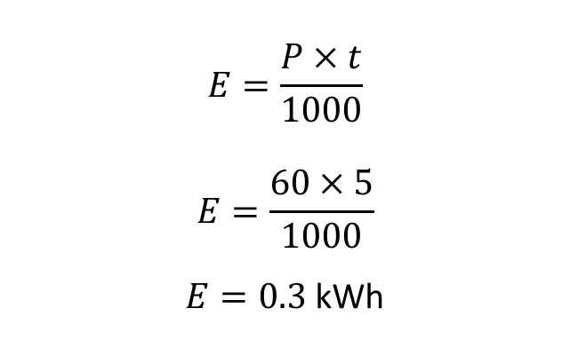
24
7
30
Units of Electricity
Date: XX/XX/2021
EQ – What are the units of electricity?
What is the formula for calculating Energy used by appliances?
The energy, (E), used by an appliance can be calculated by using this formula:
$$E=\frac{P×t}{1000}$$
where P = Power in watts
t = time in hours
How do we use the formula to calculate energy?
Example
Find the energy used by a 60 W light globe in 5 hours.
$$E=\frac{P×t}{1000}$$
$$E=\frac{60×5}{1000}$$
$E=0.3$ kWh

Slide 6
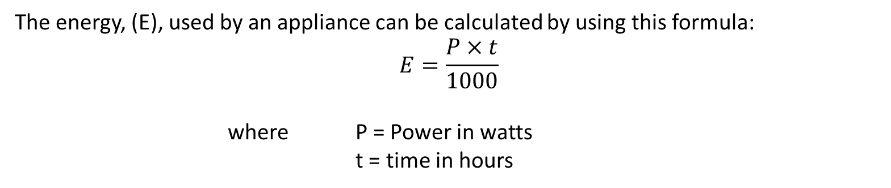

24
7
30
Units of Electricity
Date: XX/XX/2021
EQ – What are the units of electricity?
How do we use the formula to calculate energy?
The energy, (E), used by an appliance can be calculated by using this formula:
$$E=\frac{P×t}{1000}$$
where P = Power in watts
t = time in hours
How do we calculate Energy when we have kW?
Example
Find the energy used by a 6kW heater that is used for 4 hours and 15 minutes to heat a room.
$$E=P×t$$
$$E=6×4.25$$
$E=25.5$ kWh

Slide 7
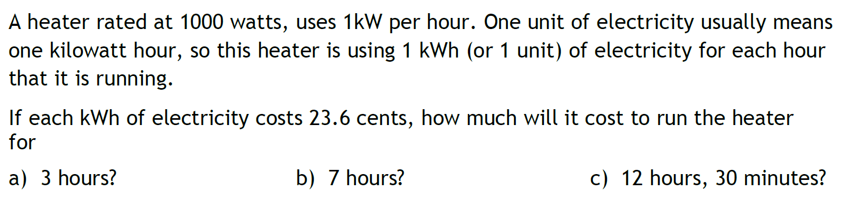
Task

Slide 8
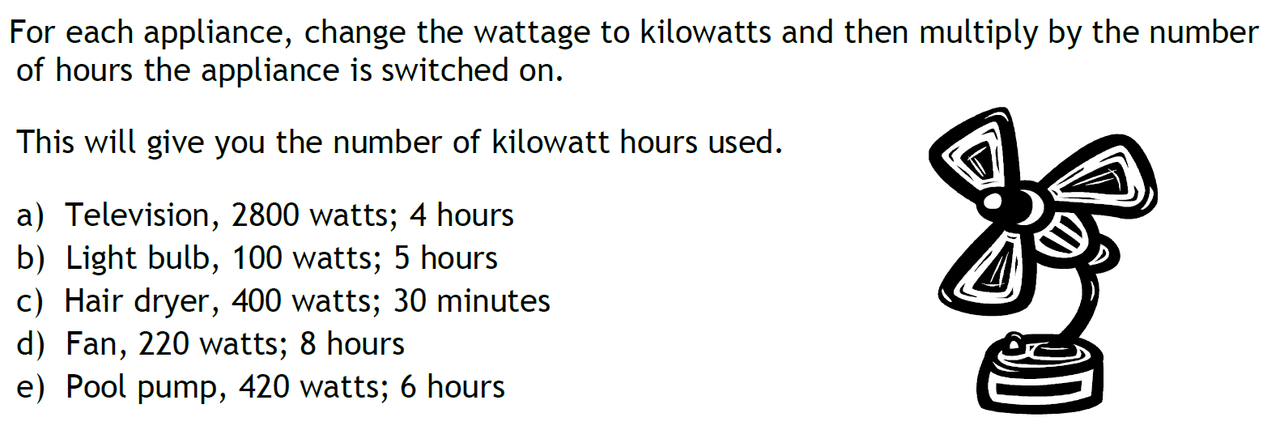
Task

Slide 9
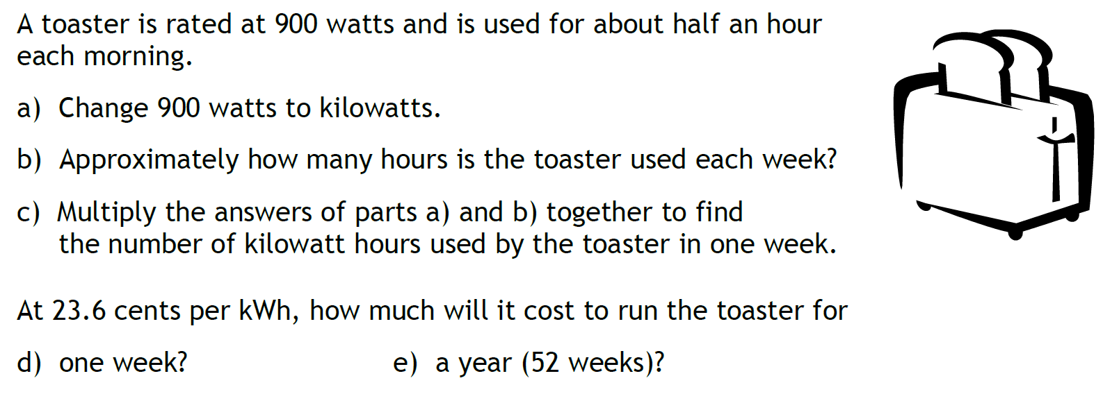
Task

Slide 10
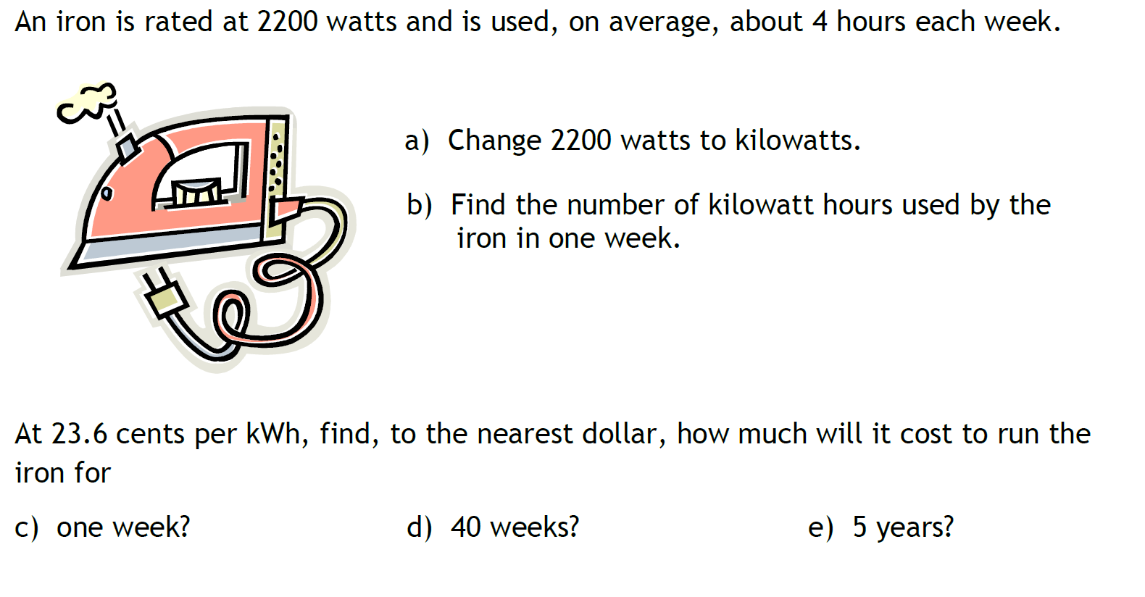
Task

Slide 11
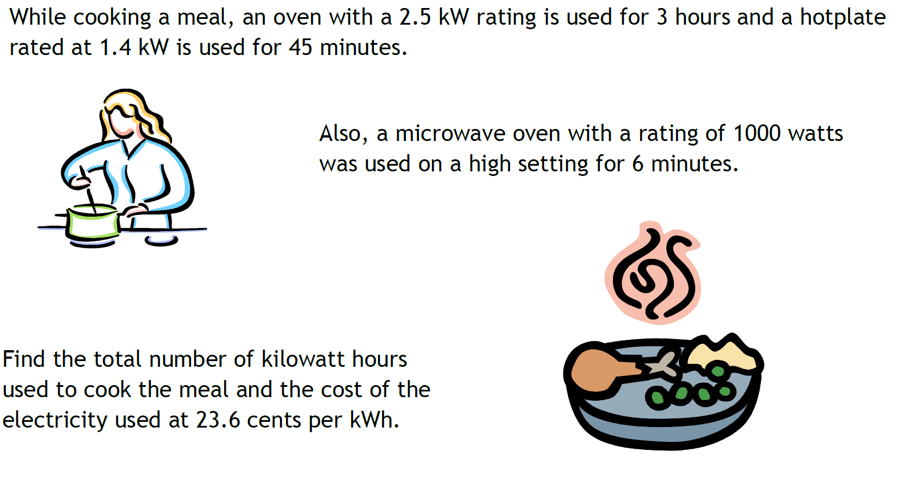
Task

